Slide 1
Marketing Initiatives
Growing Strong, Growing Faster!
Build Our Brand’s Voice

Slide 2
Positioning
Brand Visibility
Positioning of Web Werks - Iron Mountain JV at the top of the mind among TGs.
Full/ half page ads in news papers, followed by campaign sustenance with call to action.
Goodwill campaigns to induce a positive image of WEB WERKS | IRON MOUNTAIN COMBINE as the ultimate in DC in terms of product and service delivery.
Key Messaging - Iron Mountain’s global saga and domain expertise is second to none with majority of fortune 1000 companies being served.
Launch Events for upcoming new DCs in Mumbai, NCR, Bangalore, Chennai & Hyderabad.
Enterprise Connect Program ‘Leaders Forum’ – to engage with IT leaders
Shout-out (outdoor & print ads), customer engagements, new DC launches, curated DC visits
Print Advertisements
Financial news papers, corporate business magazines
CIO Evangelism
Direct connect with CIOs through multiple engagement channels
Digital Splash
With LinkedIn (organic/ paid), programmatic paid ads in Google, Emailers, YouTube videos

Slide 3
Lead Generation – Inbound & Outbound
Events
Inside Sales
Paid & Organic Social Media
Content Marketing (Search Blogs)
Email Marketing
Telecalling – Contacting Decision Makers
Generate Sales Qualified Leads
Generate Meetings for Sales with Key IT Decision Makers
Generate DC Visits from target Decision Makers

Slide 4
Few Snippets

Slide 5
Television Coverage by Business Channels
A special show was aired on CNBC TV 18 channel, followed by the release of the podcast and the article, amplified by Forbes. Show featured exclusive interview of Nikhil, and key notes from William Meaney, Mark Kidd.
Live panel on newsX channel with Industry leaders; overview of the Indian DC market. Nikhil represented WW-IMDC JV, and spoke about India expansion plans.

Slide 6
Industry Buzz with More Visibility to the JV
Industry Events | State Government Recognition | Accolades
Tamil Nadu & Karnataka’s state governments announced MOUs signed with WW-IMDC JV for investments in respective states.
CIO Crown Platform - Exclusive launch of WW-IMDC JV with Michael Goh & Nikhil Rathi
BFSI Excellence Awards – award for ‘Innovative Service Provider Of The Year’.
10th Edition Data center Summit and Awards - award for ‘Data Security’.
W.Media SA Cloud & Datacenter Award - award for 'Internet Exchange Expansion & Innovation' for the project Most Connected Datacenter in India.

Slide 7
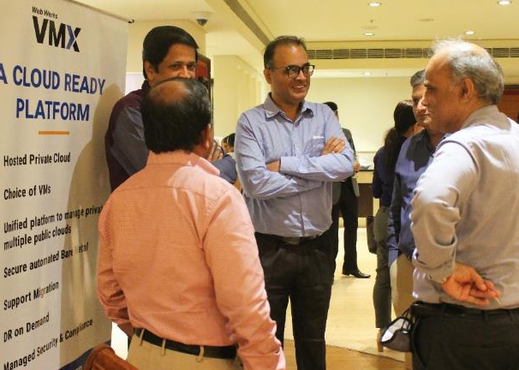
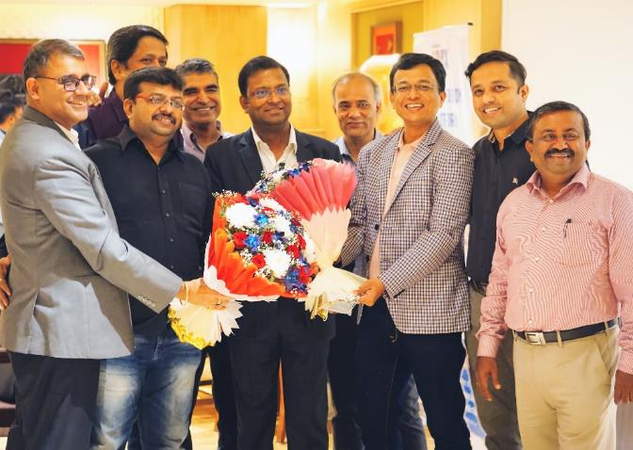
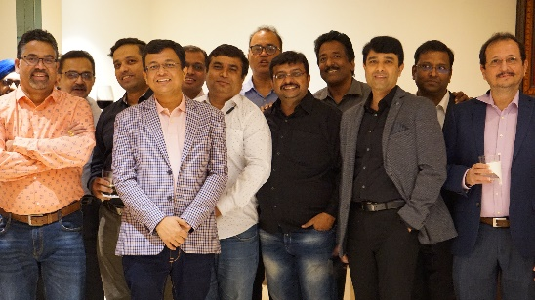
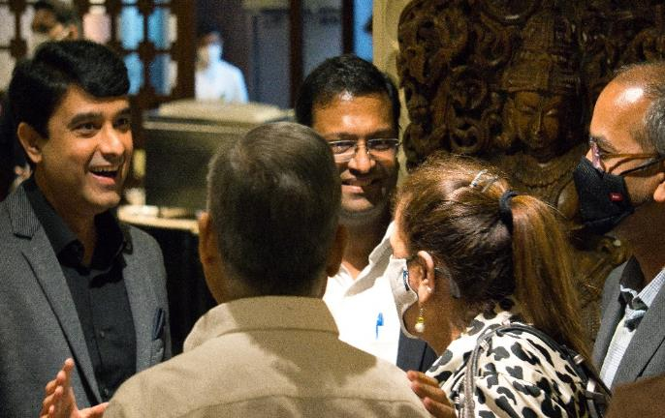
Industry Buzz with More Visibility to the JV
Accolades
CIO Evangelism
‘CIO Choice 2022 Award’ in the
‘Edge Computing Infrastructure’ category
CIO CHOICE is the de facto “Trust Seal” bestowed upon the ICT brands by the CIOs.
Events and Round Tables planned/ executed in Mumbai, Pune, Bengaluru, Hyderabad to connect with key IT decision makers across industries to generate pipeline.

Slide 8
Leaders Forum – An Enterprise Connect Program
Exclusive Event for IT Leadersc
Mumbai | Pune | NCR | Bangalore | Chennai | Hyderabad
Converse
Convert
Connect

Slide 9
Thank You!

