Slide 1
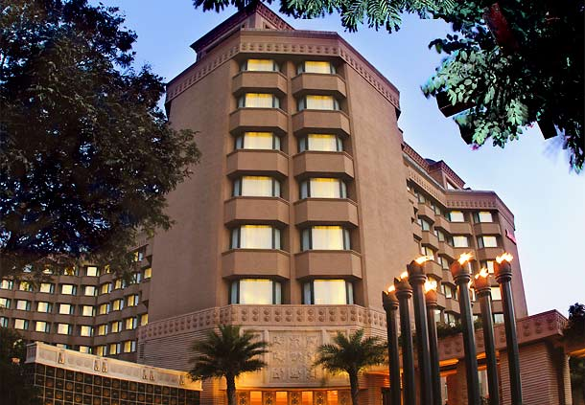
VICEROY HOTELS LIMITED
PORTFOLIO

Slide 2
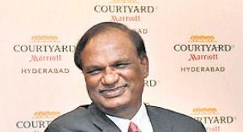
Key Management Profile
PROMOTER
Mr P. Prabhakar Reddy, aged 64 years, is a Law Graduate and has over 3 decades of experience in Hospitality Sector.
Mr Reddy is an experienced and resourceful businessman with good track record in his business ventures.
Mr Reddy is also engaged in various social activities and is a former Member of Parliament (Rajya Sabha).
BOARD OF DIRECTORS
MR P. PRABHAKAR REDDY | CHAIRMAN & MANAGING DIRECTOR
MR. P. CHAKRADHAR REDDY | DIRECTOR
MR NARASIMHA RAO KOPPURAVURI | DIRECTOR
MRS. P. KAMESWARI | DIRECTOR
MR. D.GOVINDA RAJ | DIRECTOR
MR.K. RAJESH | DIRECTOR

Slide 3
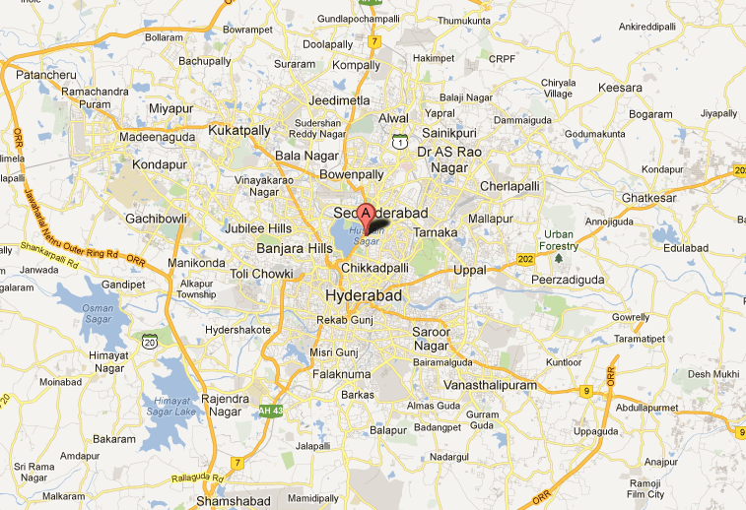
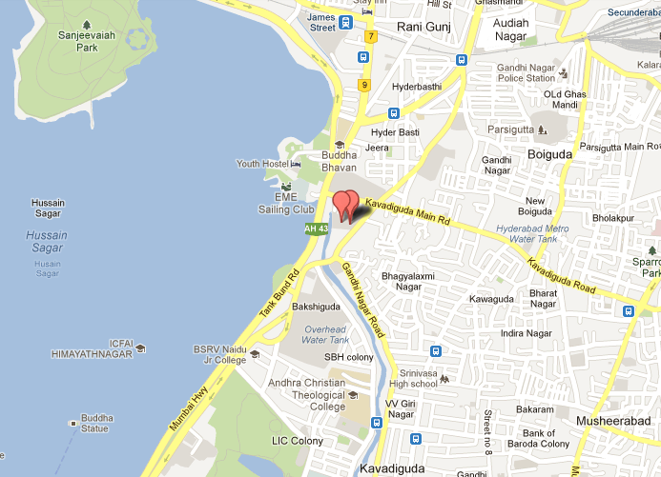
Property & Location Snapshots
Strategic Location
Located at the heart of the CBD opposite the picturesque Hussain Sagar Lake
Easy access to International Airport, the U.S. Consulate, Government Secretariat, Hi-tech city & New IT Campuses ( Uppal ), new AIIMS and shopping.
Hotels together offer largest aggregation of rooms & convention space at a single location

Slide 4
Marriott Hyderabad Hotel & Convention Centre

Slide 5
Snapshot
The property is a 5-Star Deluxe hotel, spread across 3.5 acres, over looking the Hussain Sagar Lake, operational since April 2005.
It offers 297 luxurious rooms including 1 presidential suite, 10 exclusive suites, a state-of art Gymnasium, a Spa, 4 specialty F&B outlets and Lounge.
10,000 sq ft Rooftop Bar and Lounge with PDR, Indoor, Outdoor Seating and Pool table. Largest in the city.
The hotel also offers one of the largest Convention Centre in India.
The Hotel is under Management Contract with ‘Marriott International’ with its ‘Marriot’ brand.

Slide 6
Our Consultants
Interior Designs : Jeffrey Wilkes & Associates, KL
Landscaping &
Hardscaping : Bill Bensley , Bangkok
Lighting : Tony Corbett, UK
Graphic Design : Corlett Design, AUS

Slide 7
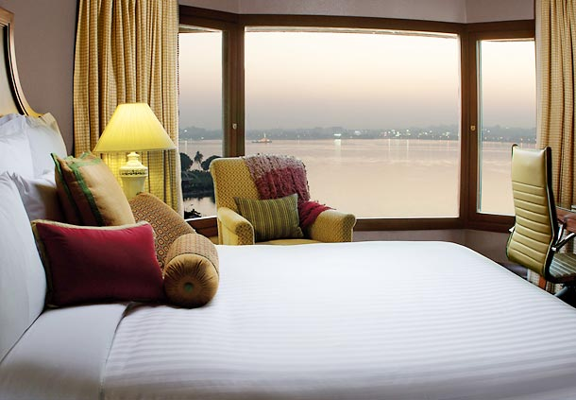
Marriott Hyderabad – Rooms
Room Configuration | No. of Rooms
Premier Club | 106
Lake View | 40
Executive rooms | 140
Suite Rooms | 10
Presidential Suite | 1
Total | 297

Slide 8
Mariott Hyderabad - Competition
Hotel
Rooms
Taj Krishna 258
Taj Deccan 151
ITC Kakatiya 189
THE PARK 270

Slide 9
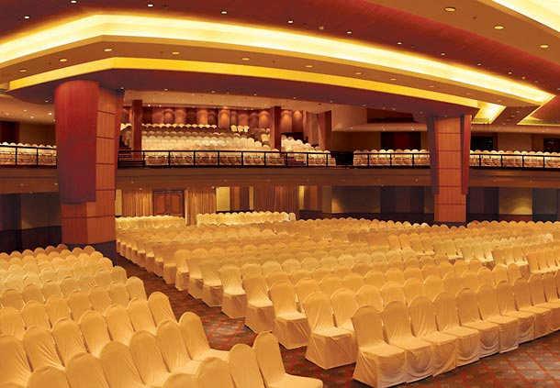
Marriott Hyderabad – Convention Center
Marriott Convention Centre
Suitable for Business Convention, Associations AGM’s, Weddings and Reception

Slide 10
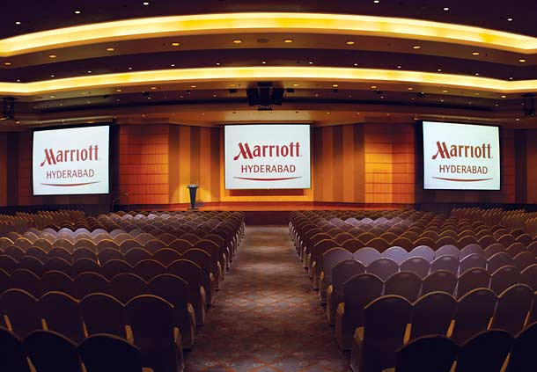
Marriott Hyderabad – Conference Space
The property has one of India's largest and most advanced venues for meetings, conventions, weddings and major conferences (55,972 sq ft ).
Convention centre measuring 14,000 sft with 20,000 sft attached lawn area.
16 Meeting rooms / Halls (Including 6 of Courtyard).
All Areas have modern AV facilities with wired / wireless internet access.

Slide 11
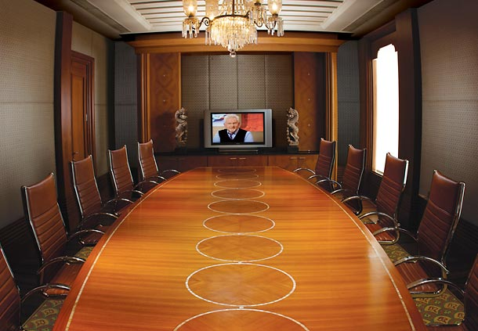
Marriott Hyderabad – Meeting Rooms
Meeting Rooms with qualified support services

Slide 12
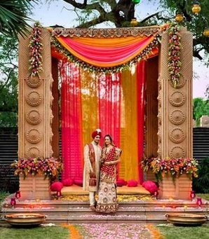
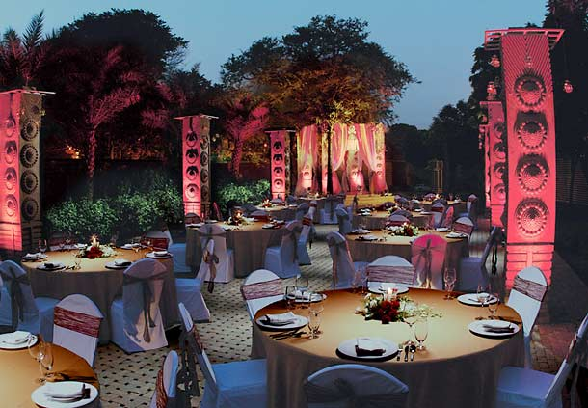
Marriott Hyderabad – Social Events
Pearl Gardens
Sapphire Ballroom

Slide 13
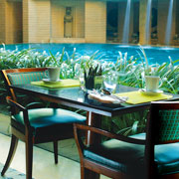
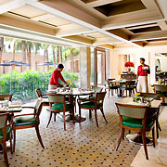
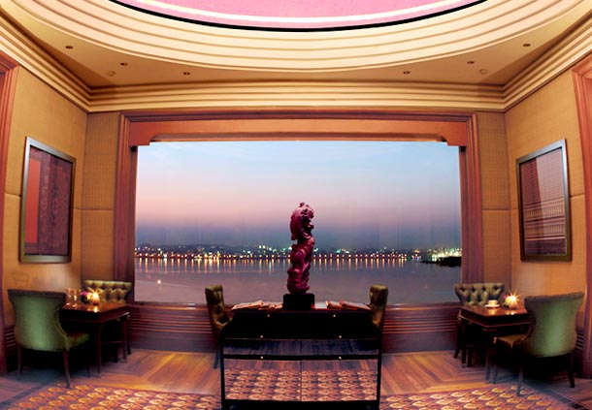
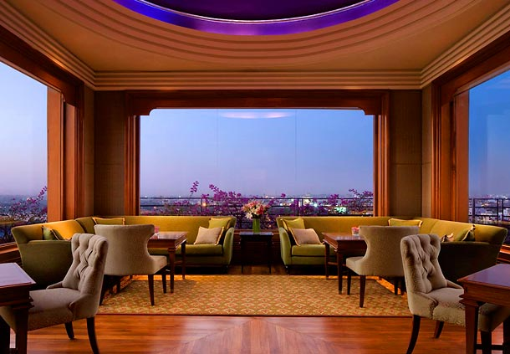
Marriott Hyderabad – F & B
OKRA
INTERNATIONAL (Covers 200)
Multi Cuisine restaurant open for 24 hrs.
Located at Lobby with swimming pool view.
Breakfast, lunch and dinner.
ALTITUDE Lounge Bar
INTERNATIONAL (Covers 200)
On the 8th floor opens in the evenings .
Eclectic mix of food , drinks and glamour.
Has a spectacular panoramic view of the magnificent Hussain Sagar Lake with indoor and open to sky seating .

Slide 14
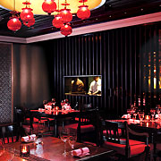
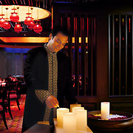
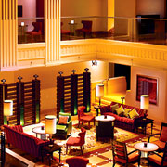
Marriott Hyderabad – F & B
BIDRI
Indian Culinary (Covers 100)
Authentic cuisine from Andhra, Hyderabad, Kashmir and Lucknow.
Located at Lobby level.
For dinner.
HBC (Hyderabad Baking Company)
Deli
Grab n Go Concept .
Serves Sandwiches, Pastries, crisp cookies, healthy breads, aromatic coffee etc.
Located in the lobby.

Slide 15
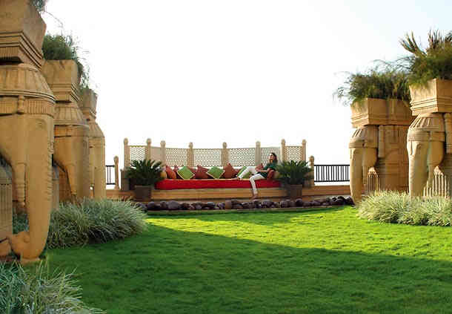
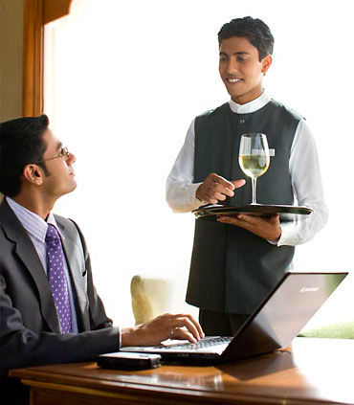
Marriott Hyderabad – F & B
CLUB LOUNGE
Open to residents of club rooms, suites and Marriott reward Members.
Located at Mezzanine Level over looking front lawn.
Open for complimentary breakfasts and cocktails.
PATIO
Located on Second Floor .
10,000 Sq ft with 3,000 Sq ft open to sky.
Used as common buffet dining area for meeting rooms on the floor .

Slide 16
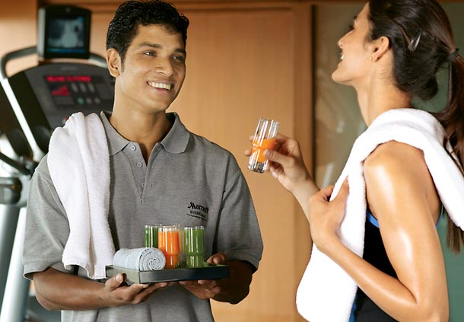
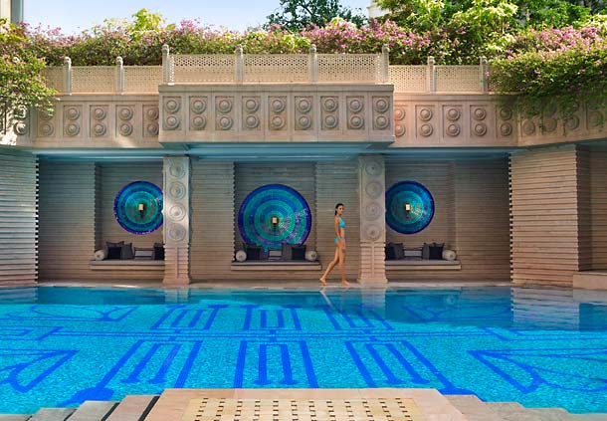
Marriott Hyderabad – Health & Fitness
Spa with treatment rooms .
Fully equipped Gym with Steam rooms.
Swimming Pool .

Slide 17
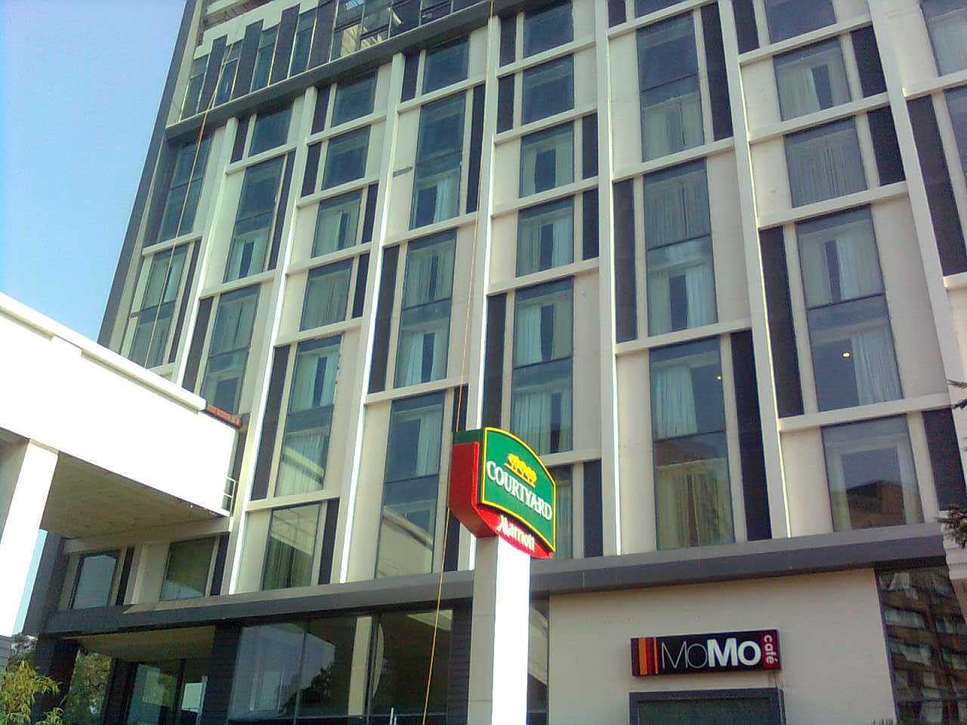
Courtyard by Marriott, Hyderabad

Slide 18
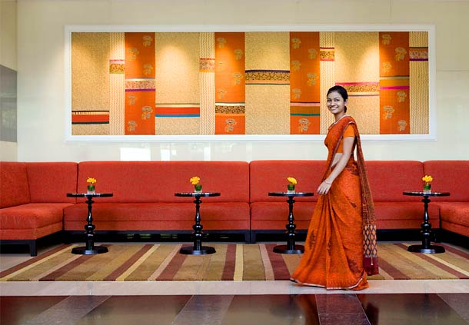
Courtyard Hyderabad– Property Overview
Viceroy Hotels Limited has built Courtyard Hyderabad, next to Marriott Hyderabad, complementing the existing hotel with its modern design and contemporary styling.
The Hotels has 200 high-end business rooms located on the Hussain Sagar Lake Road, Hyderabad, and adjacent to the Marriot. Hotel spreads across ~1.5 acres with built-up area of around 2.67 lakhs sq. ft.
Courtyard Hyderabad will be managed by Marriott for 30 years and is among the first new age Courtyards in India to follow the MoMo Concept in Restaurant.

Slide 19
Courtyard Hyderabad– Snapshot
Courtyard, a contemporary property, is a four star premier hotel in Hyderabad popular among business travellers and is operational since 2009.
The Hotel offers 200 well appointed rooms under various categories (112 Currently Operational and remaining needs to be fitted out ).
15,000 Sq ft of Spa, Salon and Treatment rooms on the Topmost floor.(PROPOSED)
15,000 sq ft Roof Top for Gym and Swimming Pool .(PROPOSED)
Dedicated Elevators for member patrons as well as Residents of Marriott.
Situated on lower Tank Bund Road, the Hotel is connected to Marriott Hyderabad via Sky bridge( 8 Meters Wide).
It is under Management Contract with ‘Marriott International’ with its ‘Courtyard’ brand.

Slide 20
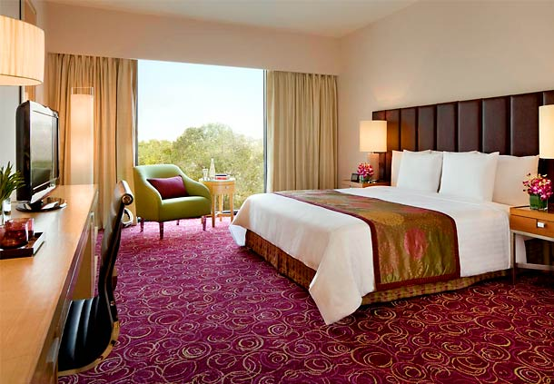
Courtyard Hyderabad – Rooms
Room Configuration | No. Rooms
Standard Room | 138
Executive rooms | 48
Executive Suite | 14
Total * | 200
*112 rooms are currently operational

Slide 21
Courtyard Hyderabad - Competition
Hotel
Rooms
Taj Vivanta 181
Green Park 148
Marigold 180
Minerva Grand, Secunderabad 139

Slide 22
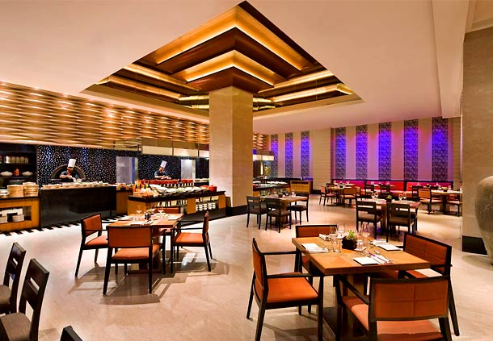
Courtyard Hyderabad – F & B
MoMo Café, (covers 100) the all-day dining restaurant at Courtyard by Marriott, Hyderabad, offers an exciting menu with an Asian touch.
The restaurant offers various options from large buffet for Breakfast, Lunch and Dinner.
MoMo Café has an open display kitchen, friendly wait staff and a vibrant interior for a refreshing experience.

Slide 23
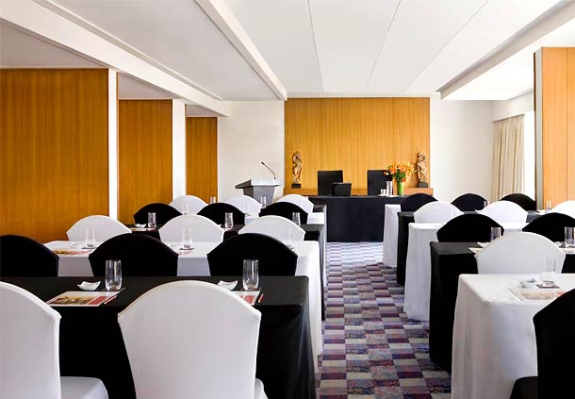
Courtyard Hyderabad – Conference facilities
The Hotel has 6 meeting rooms offering clients tailor-made solutions for their conventions, meetings and conferences. Around 28 rooms in the 2nd floor are modified to 6 large meeting rooms.
Together these meeting rooms provide 6,727 sqft. of meeting space.

Slide 24
Market Analysis: Hyderabad
Key Highlights
Business travellers and MICE account for 85-90 per cent of the premium segment hotel demand in Hyderabad.
Demand for hotel rooms in the premium segment is mainly driven by IT/ITeS companies, Pharma , Bio-Tech, Infra, Medical conferences, Defence, Airline Crews, Government and finance. Many Fortune 500 corporations and major Indian PSU giants have their offices in Hyderabad.
CRISIL Research expects room demand from premium segment hotels to grow substantially because of macro economic growth in the state of TELANGANA and ANDHRA PRADESH after separation, Hyderabad being common capital for 10 years .

Slide 25
FUTURE
MICE activities are expected to be one of the key drivers of room demand in Hyderabad.
MICE infrastructure is already present in the form of India's largest convention centre (Hyderabad International Convention Centre) and a state-of-the-art exhibition centre (HITEX Exhibition Centre) and Hyderabad Marriot Hotel and Convention Centre.
New Plans announced by the Government includes large Cultural, Convention and interaction auditoriums to accommodate 700 to 10,000 people – This will be in close proximity ( 3 KM) of The Marriott and Courtyard Hotels.
Proposed Cultural and Convention Center :

Slide 26
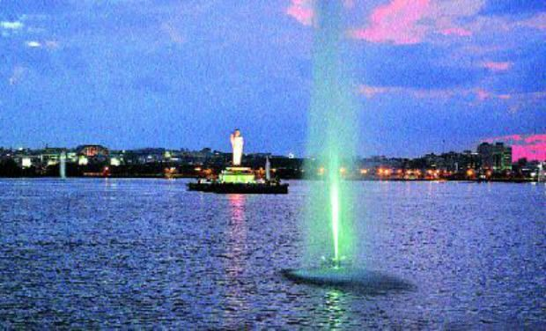
FUTURE
Proposed hub of 200 acrs meant for Restaurants, Highrise commercial complexes, malls, water sports and Theme Parks around the Lake.
Funding of the cleaning of the lake by JICA – Japanese Funding Agency.

Slide 27
Our USP
The only Integrated Hotel and Convention complex in the city with the Marriott Hyderabad and Courtyard Hyderabad connected by an internal sky bridge.
Gives total room count of 500.
16 Meeting rooms – Ideal for international conferences as breakaways.
No land parcels available in the CBD for purposes of Hotels .

Slide 28
Financial Excerpts
(In INR Lacs )
Particulars | 2017 | 2018 | 2019 | 2020 | 2021 |  | 2017 | 2018 | 2019 | 2020
Total Revenues | 6478 | 6336 | 6839 | 6811 | 2271 |  | 1885 | 1929 | 1969 | 2020
Room Revenue | 2715 | 2602 | 2802 | 2850 | 950 |  | 1251 | 1264 | 1266 | 1348
F & B, Other Revenue | 3763 | 3734 | 4037 | 3971 | 1321 |  | 634 | 665 | 703 | 671
EDBIDTA | 2,108 | 1286 | 110 | 1772 |  |  | 755 | 667 | 608 | 773

Slide 29
THANK YOU

