Slide 1

BLUELEO ENERGY PRIVATE LIMITED
VISION: TO LEAD TRANSISSION TOWARDS CLEANER ENERGY

Slide 2

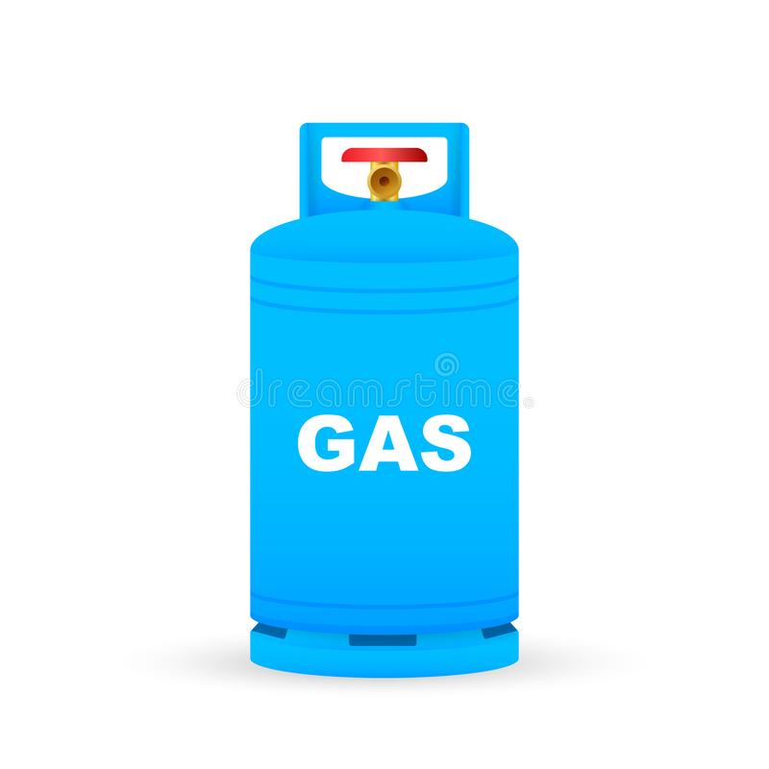




WHAT WE DO?
WE GROW NAPIER GRASS
AS ORGANIC FEED INTO
ANAEROBIC DIGESTER IN ABSENCE OF OTHER ORGANIC WASTE.
BIOGAS PRODUCED IS
FURTHER PROCESSED TO GRID GRADE
& BOTTLED USING OUR PROPRIETARY TECH
OIL MARKETING
COMPANIES
*REPLACEMENT FOR LPG/CNG

Slide 3

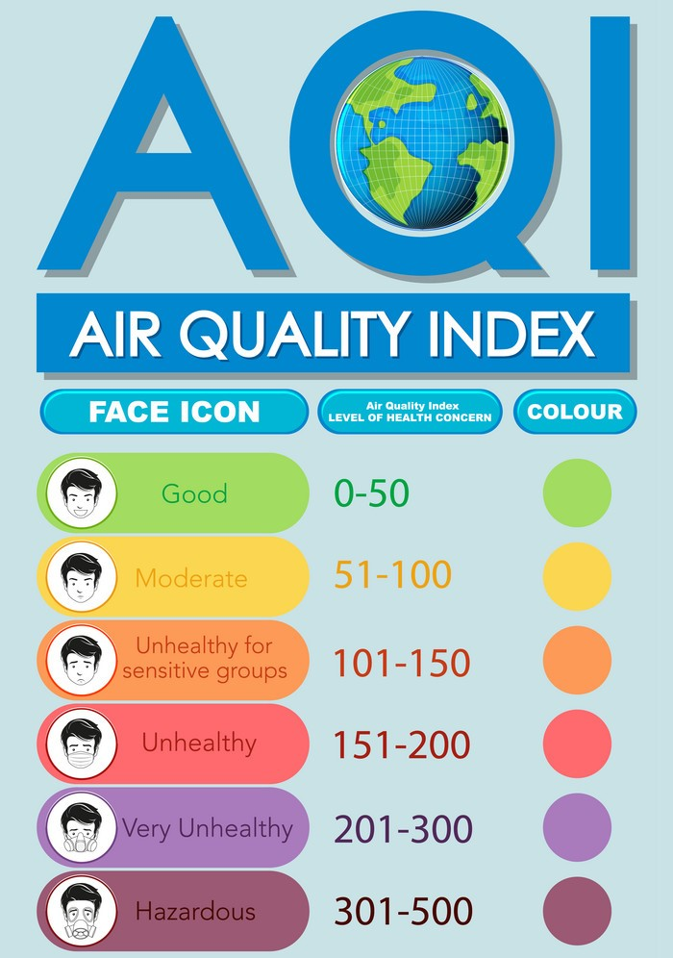
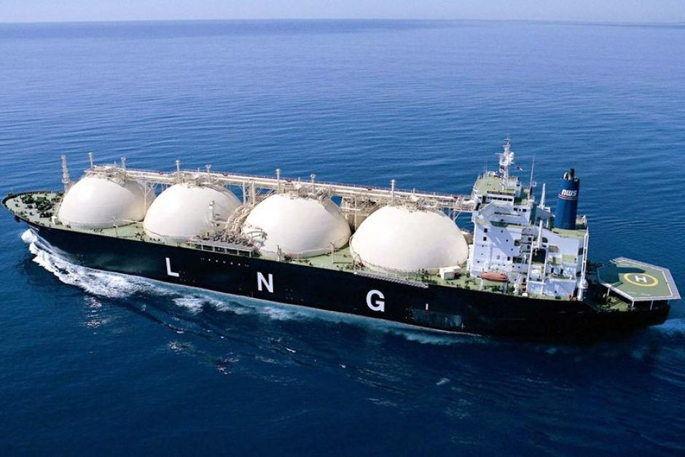
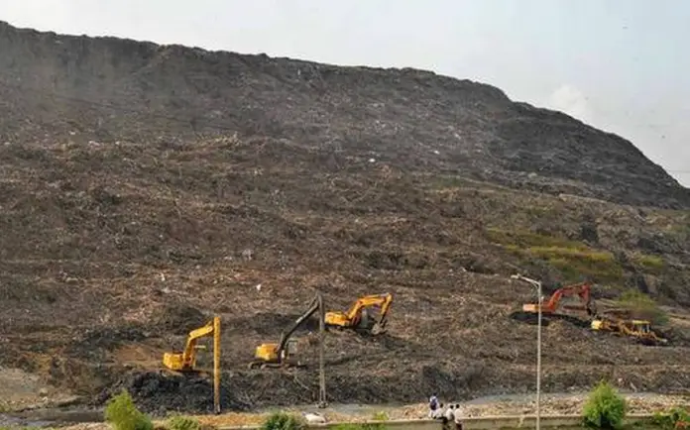
GOVERNMENT FOCUS ON BIO-CNG
ANUALLY INDIA IS FACING IMPORT BURDEN OF 10 BILLION USD AS WORLS LARGEST LNG IMPORTER.
MSW LANDFILLS
AIR QUALITY DEGRADATION

Slide 4
SATAT SCHEME
GUARANTEED OFFTAKE OF CBG BY OIL MARKETING COMPANIES.
FRONT END SUBSIDY FROM MNRE – 80 LAKHS PER TON (PLANT CAPACITY).
GENERATION OF ORGANIC MANURE.
TARGET TO SETUP 5000 PLANTS ACROSS INDIA BY 2025

Slide 5


PLANT DETAILS
PLANT CAPACITY – 6000 M3/DAY .
BIO- CNG PRODUCED PER DAY – 2.5 TPD (2500 KG/DAY).
NAPIER GRASS REQUIRED PER DAY – 50 TPD (50,000 KG/DAY).
ORGANIC FERTILIZER PRODUCED PER DAY – 12 TPD (12,000 KG PER DAY).
AREA REQUIRED FOR PLANT SETUP – 2.5 ACRES ( REGISTERED LEASE LAND).
AREA REQUIRED FOR FARMING NAPIER – 50 ACRES ( WITH SUPPLY AGGREMENT).

Slide 6

PLANT ECONOMICS
REVENUE FROM GAS PER DAY
?
1,75,000.00
REVENUE FROM FERTILIZER PER DAY
?
24,000.00
TOTAL REVENUE /DAY
?
1,99,000.00
TOTAL REVENUE /MONTH
?
49,75,000.00
TOTAL REVENUE /ANUM
?
5,97,00,000.00
OPERATIONAL COST /DAY
?
87,500.00
OPERATIONAL COST /MONTH
?
21,87,500.00
OPERATIONAL COST /ANUM
?
2,62,50,000.00
PROFIT PER MONTH
?
27,87,500.00
PROFIT PER ANUM
?
3,34,50,000.00
* EXCLUDING LOAN AND MANAGEMENT EXPENSES

Slide 7


PLANT SETUP COST
FEED PREPERATION UNIT | ₹ 1,20,20,000.00
BIO-GAS PREPERATION UNIT | ₹ 2,89,00,000.00
BOTTLING COMPRESSOR | ₹ 1,20,00,000.00
GAS QUALITY AND AUTOMATION | ₹ 1,38,00,000.00
EFFLUENT HANDLING | ₹ 45,00,000.00
WORKING CAPITAL | ₹ 1,50,00,000.00
TOTAL AMOUNT | ₹ 7,12,00,000.00

Slide 8
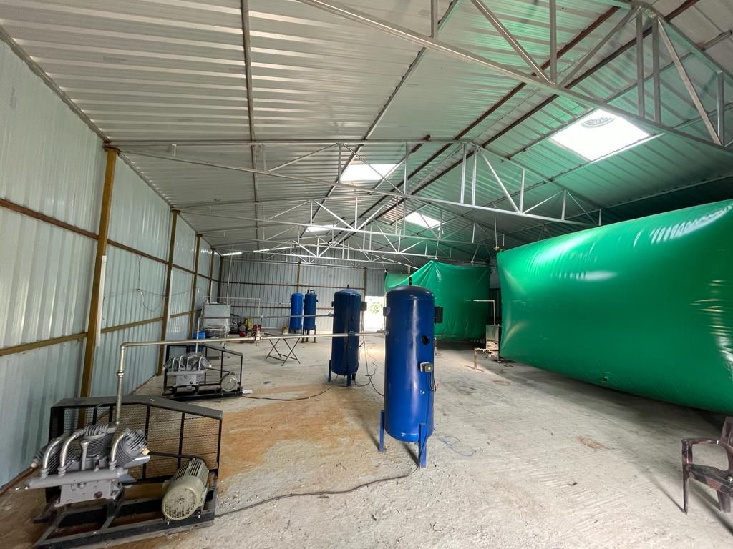
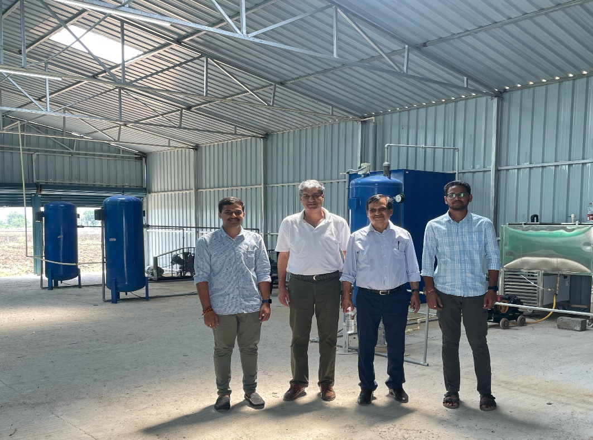
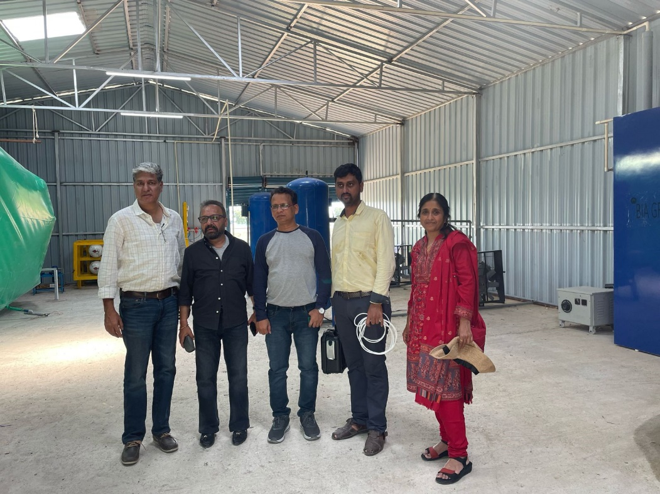
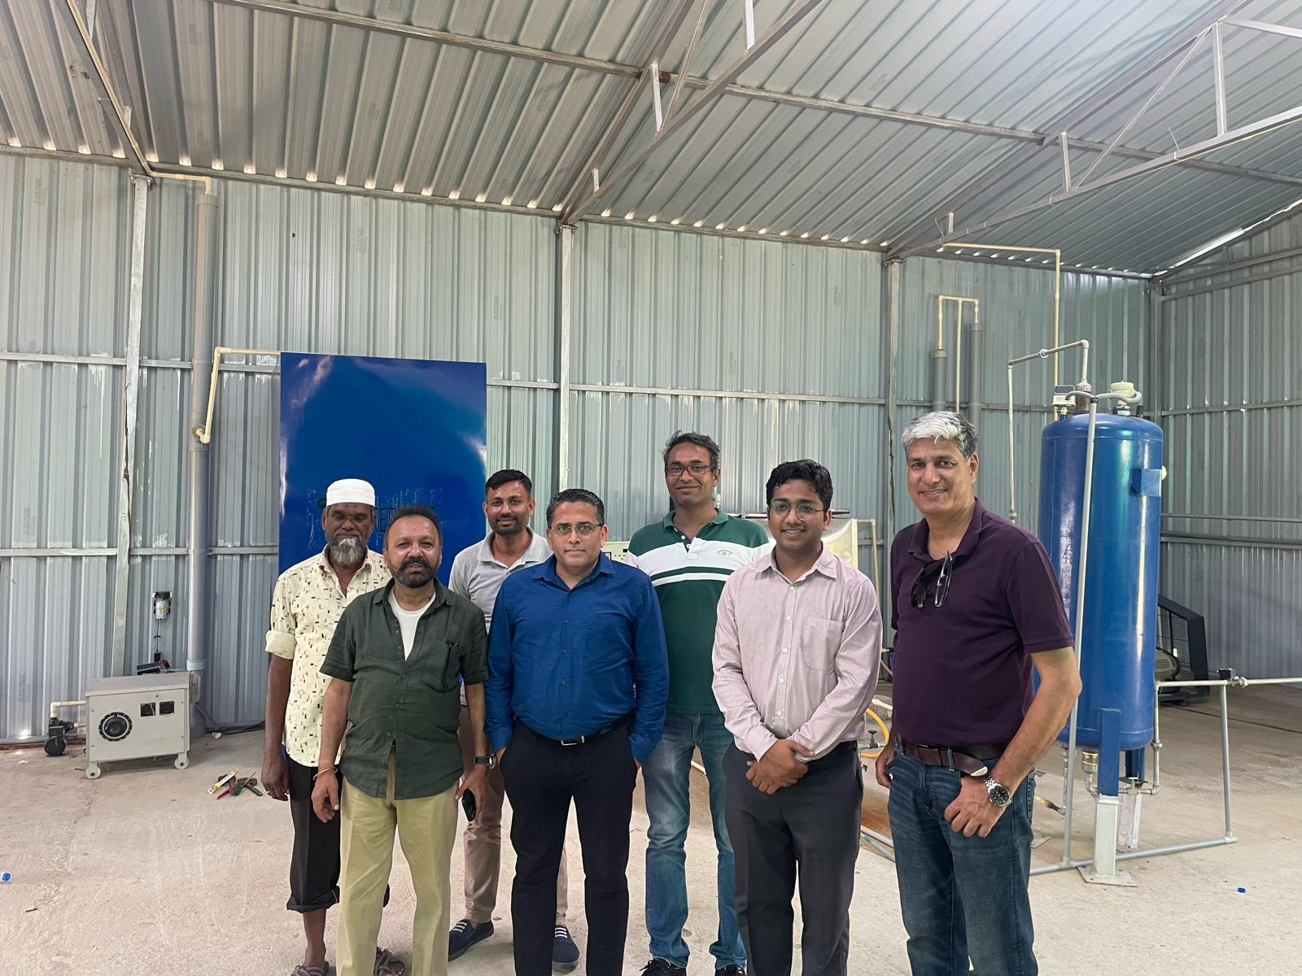
S
I
T
E
V
I
S
I
T
S

